Slide 1
TaskNag:// a progressively annoying reminder app
GROUP NUMBER - 3
Al Hulaton
Jack Bassil
Michael Smith
Randy Pellegrini
Sorawis Nilparuk (Bo)

Slide 2

What is TaskNag://
What did the team do?
Created a prototype to explore a better reminder system
Why did the team do it?
People make appointments, but forget about them.
We are trying to help users who forget appointments.
What worked?
Individual pieces worked well. Challenge was weaving it all together
Notes:
What did you do? So we created a unique reminder app where users can choose preset voice personas to call if they forget to take action on a scheduled task. Personas range the spectrum from being politefully friendly to naggingly embarrassing by using Amazon Polly text to voice service. Polly includes a number of Neural Text-to-Speech (NTTS) voices.
Why did you do it? By using the Neural TTS technology, we were able to craft increasingly annoying (yet effective) text to speech reminders.

Slide 3
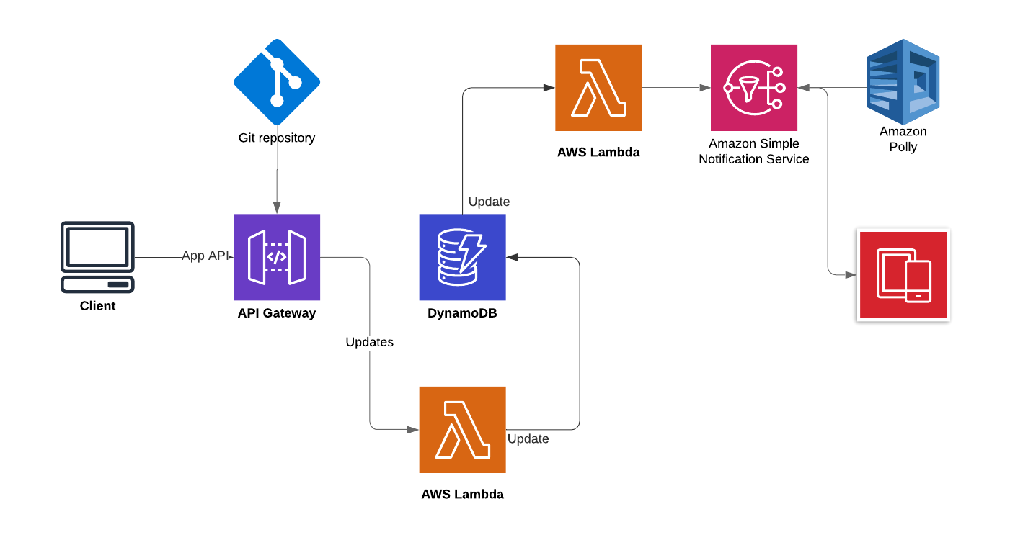
HOW DID YOU CREATE IT?

Slide 4

THE PATH FORWARD
How does this make things better?
Users can create an endless variety of personas to best help them take action on task reminders.
How can this be deployed?
Code could be integrated into reminder applications to implement Amazon Polly
What’s next?
We need to create a more robust front end with a variety of personas
We need to investigate feasibility of sending voice responses

Slide 5
DEMONSTRATE
Choose persona profile in app – in progress
Use app to make appointment – in progress
Processing of functionality shown on previous slide
First friendly reminder received before the appointment
Second somewhat annoying reminder if appointment is not acknowledged
Third very annoying and loud reminder if still not acknowledged
https://aws-pdx-hackathon.devpost.com/

